Slide 1
Bayesian Classification
Instructor: Qiang Yang
Hong Kong University of Science and Technology
Qyang@cs.ust.hk
Thanks: Dan Weld, Eibe Frank
Notes:
Lecture 1

Slide 2
Goal: Mining Probability Models
Probability Basics
  Our state s in world W, is distributed according to probability distribution
    0 <= Pr(s) <= 1 for all s
    ΣS Pr(s) = 1
    For subsets S1 and S2,
    Pr(S1 ∪ S2) = Pr(s1) + Pr(s2) - Pr(s1 ∩ S2)
  Bayes Rule:

Slide 3
Weather data set
Outlook | Temperature | Humidity | Windy | Play
sunny | hot | high | FALSE | no
sunny | hot | high | TRUE | no
overcast | hot | high | FALSE | yes
rainy | mild | high | FALSE | yes
rainy | cool | normal | FALSE | yes
rainy | cool | normal | TRUE | no
overcast | cool | normal | TRUE | yes
sunny | mild | high | FALSE | no
sunny | cool | normal | FALSE | yes
rainy | mild | normal | FALSE | yes
sunny | mild | normal | TRUE | yes
overcast | mild | high | TRUE | yes
overcast | hot | normal | FALSE | yes
rainy | mild | high | TRUE | no

Slide 4
Basics
Unconditional or Prior Probability
  Pr(Play=yes) + Pr(Play=no)=1
  Pr(Play=yes) is sometimes written as Pr(Play)
  Table has 9 yes, 5 no
    Pr(Play=yes)=9/(9+5)=9/14
    Thus, Pr(Play=no)=5/14
Joint Probability of Play and Windy:
  Pr(Play=x,Windy=y) for all values x and y, should be 1
Windy=True
Windy=False
Play=yes
3/14
6/14
Play=no
3/14
?

Slide 5
Probability Basics
Windy | Play
*FALSE | no
TRUE | no
*FALSE | *yes
*FALSE | *yes
*FALSE | *yes
TRUE | no
TRUE | yes
*FALSE | no
*FALSE | *yes
*FALSE | *yes
TRUE | yes
TRUE | yes
*FALSE | *yes
TRUE | no
Conditional Probability
  Pr(A|B)
  # (Windy=False)=8
  Within the 8,
    #(Play=yes)=6
  Pr(Play=yes | Windy=False) =6/8
  Pr(Windy=False)=8/14
  Pr(Play=Yes)=9/14
Applying Bayes Rule
Pr(B|A) = Pr(A|B)Pr(B) / Pr(A)
  Pr(Windy=False|Play=yes)=
    6/8*8/14/(9/14)=6/9

Slide 6
Conditional Independence
“A and P are independent given C”
Pr(A | P,C) = Pr(A | C)
C A P Probability
F F F 0.534
F F T 0.356
F T F 0.006
F T T 0.004
T F F 0.048
T F T 0.012
T T F 0.032
T T T 0.008
Ache
Cavity
Probe
Catches

Slide 7
Conditional Independence
“A and P are independent given C”
Pr(A | P,C) = Pr(A | C) and also Pr(P | A,C) = Pr(P | C)
C A P Probability
F F F 0.534
F F T 0.356
F T F 0.006
F T T 0.004
T F F 0.012
T F T 0.048
T T F 0.008
T T T 0.032
Suppose C=True
Pr(A|P,C) = 0.032/(0.032+0.048)
= 0.032/0.080
= 0.4
Pr(A|C) = 0.032+0.008/
(0.048+0.012+0.032+0.008)
= 0.04 / 0.1 = 0.4

Slide 8
Conditional Independence
Can encode joint probability distribution in compact form
Conditional probability table (CPT)
C A P Probability
F F F 0.534
F F T 0.356
F T F 0.006
F T T 0.004
T F F 0.012
T F T 0.048
T T F 0.008
T T T 0.032
C P(A)
T 0.4
F 0.02
Ache
Cavity
Probe
Catches
P(C)
.1
C P(P)
T 0.8
F 0.4

Slide 9
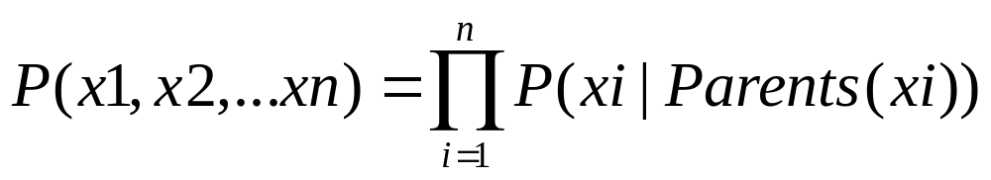
Creating a Network
1: Bayes net = representation of a JPD
2: Bayes net = set of cond. independence statements
If create correct structure that represents causality
  Then get a good network
    i.e. one that’s small = easy to compute with
    One that is easy to fill in numbers

Slide 10
Example
My house alarm system just sounded (A).
Both an earthquake (E) and a burglary (B) could set it off.
John will probably hear the alarm; if so he’ll call (J).
But sometimes John calls even when the alarm is silent
Mary might hear the alarm and call too (M), but not as reliably
We could be assured a complete and consistent model by fully specifying the joint distribution:
  Pr(A, E, B, J, M)
  Pr(A, E, B, J, ~M)
  etc.

Slide 11
Structural Models (HK book 7.4.3)
Instead of starting with numbers, we will start with structural relationships among the variables
There is a direct causal relationship from Earthquake to Alarm
There is a direct causal relationship from Burglar to Alarm
There is a direct causal relationship from Alarm to JohnCall
Earthquake and Burglar tend to occur independently
etc.

Slide 12
Possible Bayesian Network
Earthquake
Burglary
Alarm
MaryCalls
JohnCalls

Slide 13
Graphical Models and Problem Parameters
What probabilities need I specify to ensure a complete, consistent model given
  the variables I have identified
  the dependence and independence relationships I have specified by building a graph structure
Answer
  provide an unconditional (prior) probability for every node in the graph with no parents
  for all remaining, provide a conditional probability table
    Prob(Child | Parent1, Parent2, Parent3)
    for all possible combination of Parent1, Parent2, Parent3 values

Slide 14
Complete Bayesian Network
P(E)
.002
P(B)
.001
Earthquake
Burglary
B
T
T
F
F
E
T
F
T
F
P(A)
.95
.94
.29
.01
Alarm
A
T
F
P(J)
.90
.05
A
T
F
P(M)
.70
.01
MaryCalls
JohnCalls

Slide 15
Microsoft Bayesian Belief Net
http://research.microsoft.com/adapt/MSBNx/
Can be used to construct and reason with Bayesian Networks
Consider the example

Slide 16
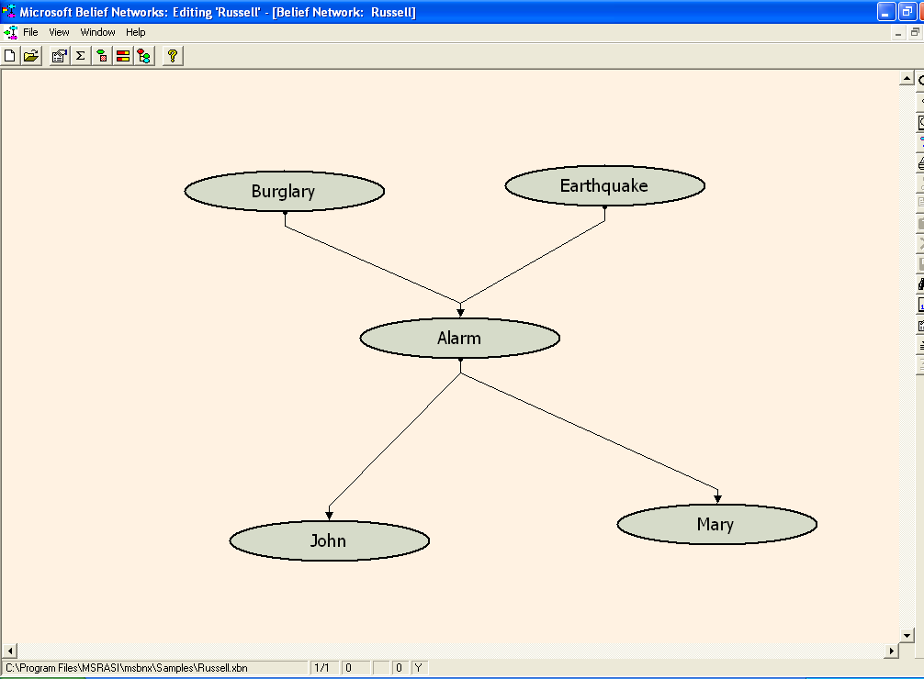

Slide 17
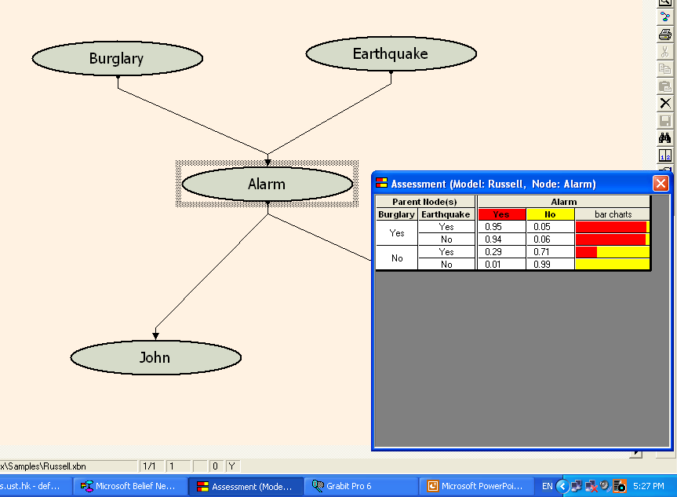

Slide 18
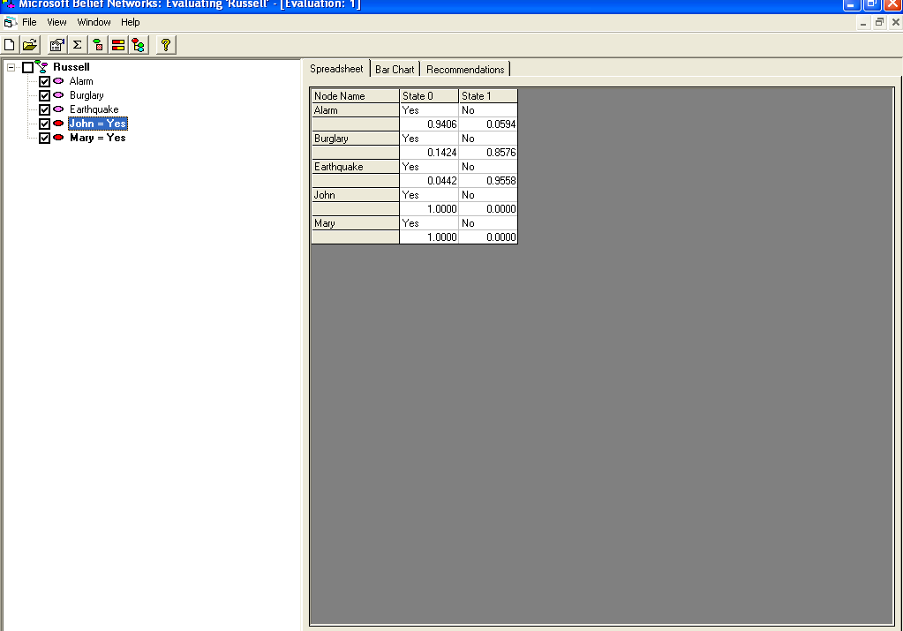

Slide 19
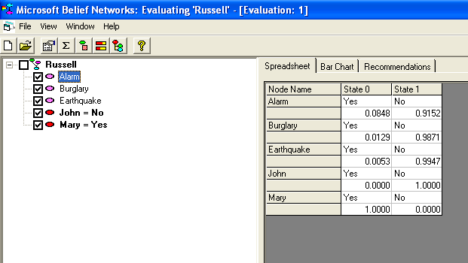

Slide 20
Mining for Structural Models
Difficult to mine
  Some methods are proposed
  Up to now, no good results yet
Often requires domain expert’s knowledge
Once set up, a Bayesian Network can be used to provide probabilistic queries
  Microsoft Bayesian Network Software

Slide 21
Use the Bayesian Net for Prediction
From a new day’s data we wish to predict the decision
New data: X
Class label: C
To predict the class of X, is the same as asking
  Value of Pr(C|X)?
    Pr(C=yes|X)
    Pr(C=no|X)
    Compare the two

Slide 22
Naïve Bayesian Models
Two assumptions: Attributes are
  equally important
  statistically independent (given the class value)
    This means that knowledge about the value of a particular attribute doesn’t tell us anything about the value of another attribute (if the class is known)
Although based on assumptions that are almost never correct, this scheme works well in practice!

Slide 23
Why Naïve?
Assume the attributes are independent, given class
What does that mean?
play
outlook
temp
humidity
windy
Pr(outlook=sunny | windy=true, play=yes)=
Pr(outlook=sunny|play=yes)

Slide 24
Weather data set
Outlook | Windy | Play
overcast | FALSE | yes
rainy | FALSE | yes
rainy | FALSE | yes
overcast | TRUE | yes
sunny | FALSE | yes
rainy | FALSE | yes
sunny | TRUE | yes
overcast | TRUE | yes
overcast | FALSE | yes

Slide 25
Is the assumption satisfied?
Outlook | Windy | Play
overcast | FALSE | yes
rainy | FALSE | yes
rainy | FALSE | yes
overcast | TRUE | yes
sunny | FALSE | yes
rainy | FALSE | yes
sunny | TRUE | yes
overcast | TRUE | yes
overcast | FALSE | yes
#yes=9
#sunny=2
#windy, yes=3
#sunny|windy, yes=1
Pr(outlook=sunny|windy=true, play=yes)=1/3
Pr(outlook=sunny|play=yes)=2/9
Pr(windy|outlook=sunny,play=yes)=1/2
Pr(windy|play=yes)=3/9
Thus, the assumption is NOT satisfied.
But, we can tolerate some errors (see later slides)

Slide 26
Probabilities for the weather data
Outlook |  |  | Temperature |  |  | Humidity |  |  | Windy |  |  | Play
 | Yes | No |  | Yes | No |  | Yes | No |  | Yes | No | Yes | No
Sunny | 2 | 3 | Hot | 2 | 2 | High | 3 | 4 | False | 6 | 2 | 9 | 5
Overcast | 4 | 0 | Mild | 4 | 2 | Normal | 6 | 1 | True | 3 | 3
Rainy | 3 | 2 | Cool | 3 | 1
Sunny | 2/9 | 3/5 | Hot | 2/9 | 2/5 | High | 3/9 | 4/5 | False | 6/9 | 2/5 | 9/14 | 5/14
Overcast | 4/9 | 0/5 | Mild | 4/9 | 2/5 | Normal | 6/9 | 1/5 | True | 3/9 | 3/5
Rainy | 3/9 | 2/5 | Cool | 3/9 | 1/5
A new day:
Outlook | Temp. | Humidity | Windy | Play
Sunny | Cool | High | True | ?

Slide 27
Likelihood of the two classes For “yes” = 2/9 × 3/9 × 3/9 × 3/9 × 9/14 = 0.0053 For “no” = 3/5 × 1/5 × 4/5 × 3/5 × 5/14 = 0.0206 Conversion into a probability by normalization: P(“yes”|E) = 0.0053 / (0.0053 + 0.0206) = 0.205 P(“no”|Eh) = 0.0206 / (0.0053 + 0.0206) = 0.795

Slide 28
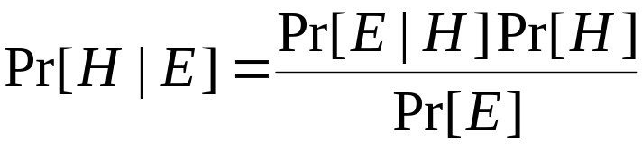


Bayes’ rule
Probability of event H given evidence E:
A priori probability of H:
  Probability of event before evidence has been seen
A posteriori probability of H:
  Probability of event after evidence has been seen

Slide 29
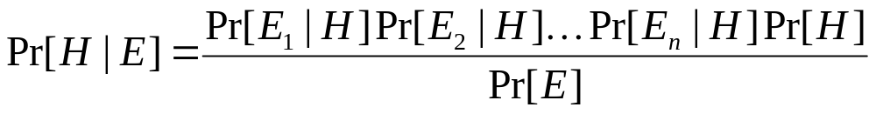
Naïve Bayes for classification
Classification learning: what’s the probability of the class given an instance?
  Evidence E = an instance
  Event H = class value for instance (Play=yes, Play=no)
Naïve Bayes Assumption: evidence can be split into independent parts (i.e. attributes of instance are independent)

Slide 30

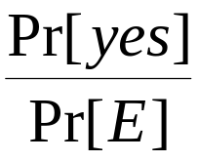

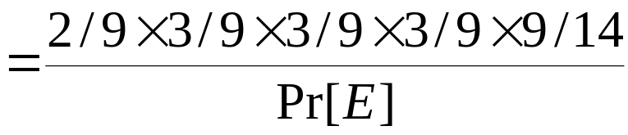
The weather data example
Outlook | Temp. | Humidity | Windy | Play
Sunny | Cool | High | True | ?
Evidence E
Probability for
class “yes”

Slide 31

The “zero-frequency problem”
What if an attribute value doesn’t occur with every class value (e.g. “Humidity = high” for class “yes”)?
  Probability will be zero!
  A posteriori probability will also be zero!
  (No matter how likely the other values are!)
Remedy: add 1 to the count for every attribute value-class combination (Laplace estimator)
Result: probabilities will never be zero! (also: stabilizes probability estimates)

Slide 32
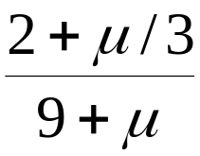
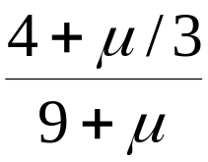
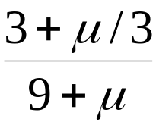
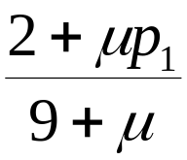
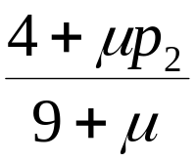
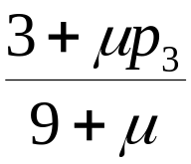
Modified probability estimates
In some cases adding a constant different from 1 might be more appropriate
Example: attribute outlook for class yes
Weights don’t need to be equal (if they sum to 1)
Sunny
Overcast
Rainy

Slide 33
Missing values
Training: instance is not included in frequency count for attribute value-class combination
Classification: attribute will be omitted from calculation
Example:
Outlook | Temp. | Humidity | Windy | Play
? | Cool | High | True | ?
Likelihood of “yes” = 3/9 × 3/9 × 3/9 × 9/14 = 0.0238 Likelihood of “no” = 1/5 × 4/5 × 3/5 × 5/14 = 0.0343 P(“yes”) = 0.0238 / (0.0238 + 0.0343) = 41% P(“no”) = 0.0343 / (0.0238 + 0.0343) = 59%

Slide 34
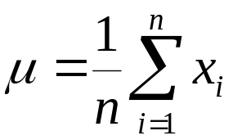
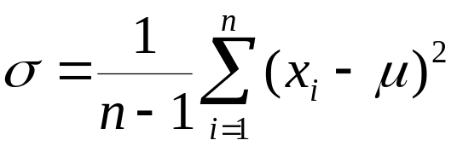
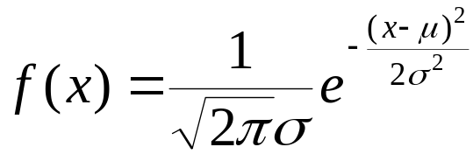
Dealing with numeric attributes
Usual assumption: attributes have a normal or Gaussian probability distribution (given the class)
The probability density function for the normal distribution is defined by two parameters:
  The sample mean μ:
  The standard deviation σ:
  The density function f(x):

Slide 35
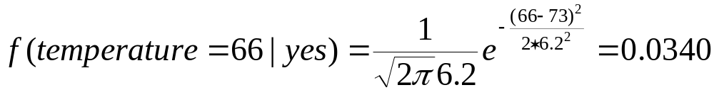
Statistics for the weather data
Outlook |  |  | Temperature |  |  | Humidity |  |  | Windy |  |  | Play
 | Yes | No |  | Yes | No |  | Yes | No |  | Yes | No | Yes | No
Sunny | 2 | 3 |  | 83 | 85 |  | 86 | 85 | False | 6 | 2 | 9 | 5
Overcast | 4 | 0 |  | 70 | 80 |  | 96 | 90 | True | 3 | 3
Rainy | 3 | 2 |  | 68 | 65 |  | 80 | 70
 |  |  |  | … | … |  | … | …
Sunny | 2/9 | 3/5 | mean | 73 | 74.6 | mean | 79.1 | 86.2 | False | 6/9 | 2/5 | 9/14 | 5/14
Overcast | 4/9 | 0/5 | std dev | 6.2 | 7.9 | std dev | 10.2 | 9.7 | True | 3/9 | 3/5
Rainy | 3/9 | 2/5
Example density value:

Slide 36
Classifying a new day
Outlook | Temp. | Humidity | Windy | Play
Sunny | 66 | 90 | true | ?
A new day:
Missing values during training: not included in calculation of mean and standard deviation
Likelihood of “yes” = 2/9 × 0.0340 × 0.0221 × 3/9 × 9/14 = 0.000036 Likelihood of “no” = 3/5 × 0.0291 × 0.0380 × 3/5 × 5/14 = 0.000136 P(“yes”) = 0.000036 / (0.000036 + 0. 000136) = 20.9% P(“no”) = 0. 000136 / (0.000036 + 0. 000136) = 79.1%

Slide 37
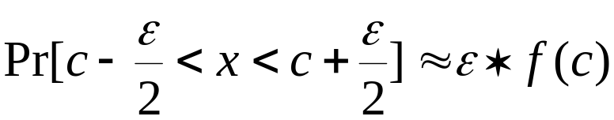
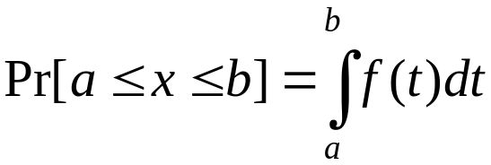
Probability densities
Relationship between probability and density:
But: this doesn’t change calculation of a posteriori probabilities because ε cancels out
Exact relationship:

Slide 38
Example of Naïve Bayes in Weka
Use Weka Naïve Bayes Module to classify
  Weather.nominal.arff

Slide 39
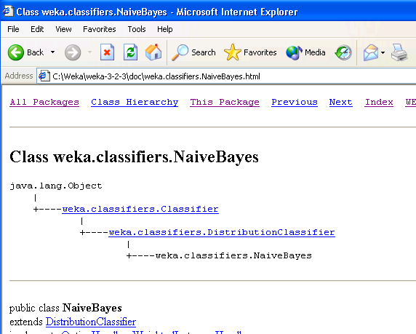

Slide 40
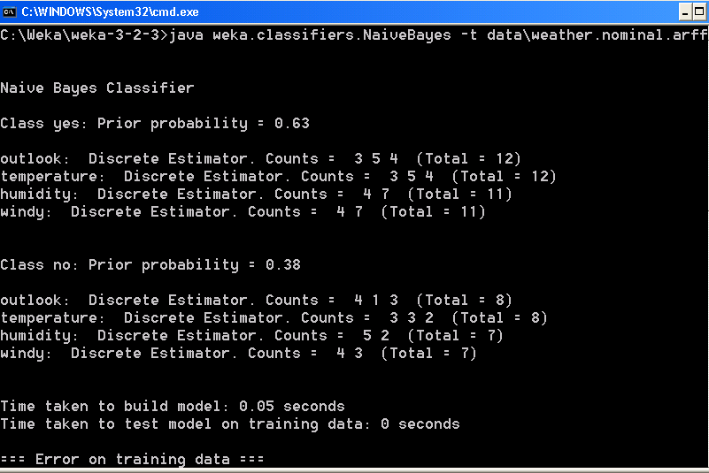

Slide 41
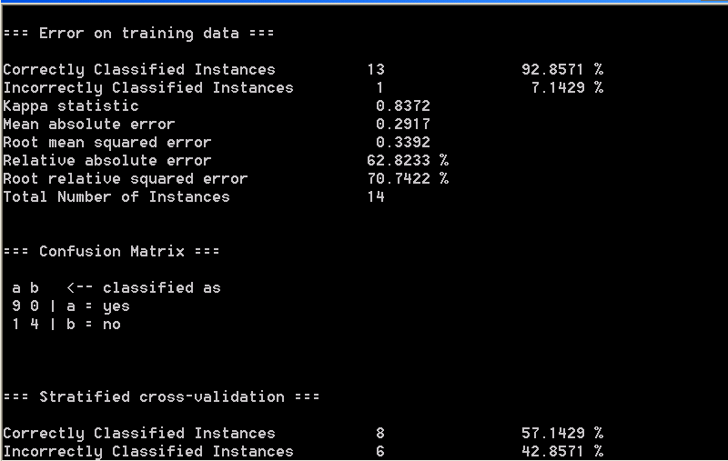

Slide 42
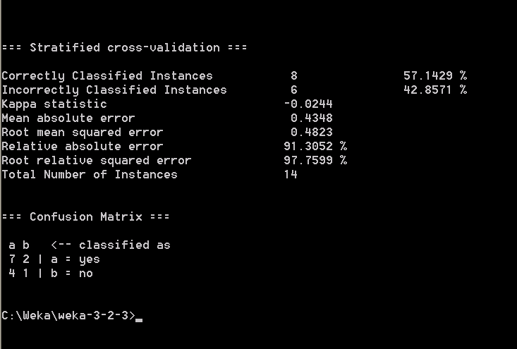

Slide 43
Discussion of Naïve Bayes
Naïve Bayes works surprisingly well (even if independence assumption is clearly violated)
Why? Because classification doesn’t require accurate probability estimates as long as maximum probability is assigned to correct class
However: adding too many redundant attributes will cause problems (e.g. identical attributes)
Note also: many numeric attributes are not normally distributed

Slide 44
Applications of Bayesian Method
Gene Analysis
  Nir Friedman Iftach Nachman Dana Pe’er, Institute of Computer Science, Hebrew University
Text and Email analysis
  Spam Email Filter
    Microsoft Work
  News classification for personal news delivery on the Web
    User Profiles
Credit Analysis in Financial Industry
  Analyze the probability of payment for a loan

Slide 45
Gene Interaction Analysis
DNA
Gene
DNA is a double-stranded molecule
Hereditary information is encoded
Complementation rules
Gene is a segment of DNA
Contain the information required
to make a protein

Slide 46
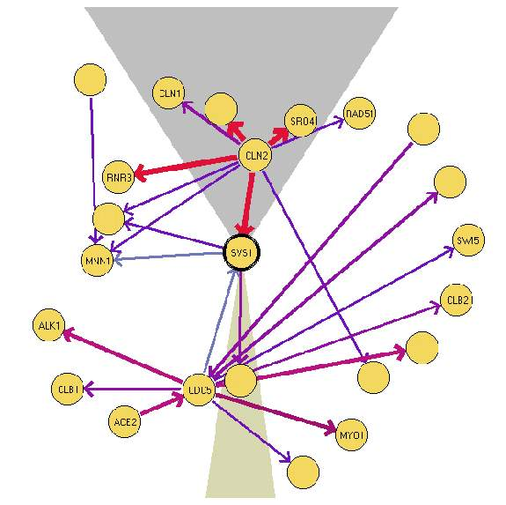
Gene Interaction Result:
Example of interaction between proteins for gene SVS1.
The width of edges corresponds to the conditional probability.

Slide 47
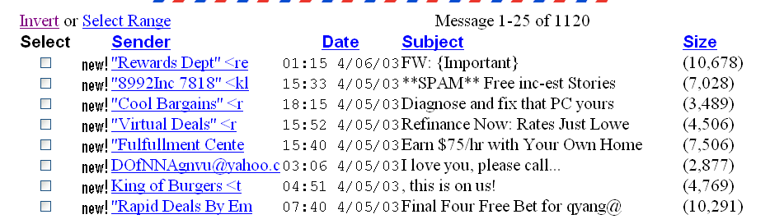
Spam Killer
Bayesian Methods are used for weed out spam emails

Slide 48
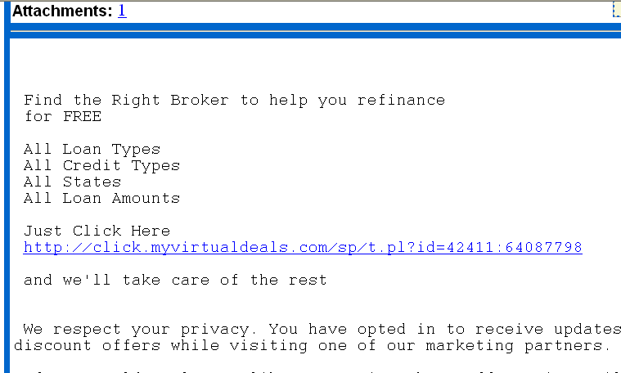
Spam Killer

Slide 49
Construct your training data
Each email is one record: M
Emails are classified by user into
  Spams: + class
  Non-spams: - class
A email M is a spam email if
  Pr(+|M)>Pr(-|M)
Features:
  Words, values = {1, 0} or {frequency}
  Phrases
  Attachment {yes, no}
How accurate: TP rate > 90%
  We wish FP rate to be as low as possible
  Those are the emails that are nonspam but are classified as spam

Slide 50
Naïve Bayesian In Oracle9i http://otn.oracle.com/products/oracle9i/htdocs/o9idm_faq.html
What is the target market?
Oracle9i Data Mining is best suited for companies that have lots of data, are committed to the Oracle platform, and want to automate and operationalize their extraction of business intelligence. The initial end user is a Java application developer, although the end user of the application enhanced by data mining could be a customer service rep, marketing manager, customer, business manager, or just about any other imaginable user.
What algorithms does Oracle9i Data Mining support?
Oracle9i Data Mining provides programmatic access to two data mining algorithms embedded in Oracle9i Database through a Java-based API. Data mining algorithms are machine-learning techniques for analyzing data for specific categories of problems. Different algorithms are good at different types of analysis. Oracle9i Data Mining provides two algorithms: Naive Bayes for Classifications and Predictions and Association Rules for finding patterns of co-occurring events. Together, they cover a broad range of business problems.
Naive Bayes: Oracle9i Data Mining's Naive Bayes algorithm can predict binary or multi-class outcomes. In binary problems, each record either will or will not exhibit the modeled behavior. For example, a model could be built to predict whether a customer will churn or remain loyal. Naive Bayes can also make predictions for multi-class problems where there are several possible outcomes. For example, a model could be built to predict which class of service will be preferred by each prospect.
Binary model example:
Q: Is this customer likely to become a high-profit customer?
A: Yes, with 85% probability
Multi-class model example:
Q: Which one of five customer segments is this customer most likely to fit into — Grow, Stable, Defect, Decline or Insignificant?
A: Stable, with 55% probability

